Slide 1



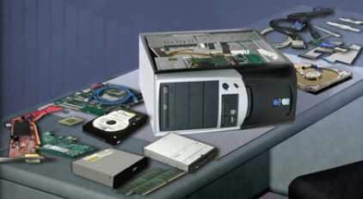
Computer Assembly
IT Essentials: PC Hardware and Software v4.0
ITE PC v4.0
Chapter 3
© 2007 Cisco Systems, Inc. All rights reserved.
Jad Njeim
1
Introduction
Computer assembly is a large part of a technician's job.
Work in a logical, methodical manner when working with computer components
Improve computer assembly skills dramatically with practice
ITE PC v4.0
Chapter 3
© 2007 Cisco Systems, Inc. All rights reserved.
Jad njeim
2

Slide 2
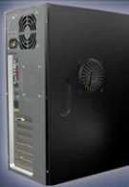
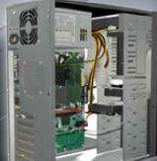
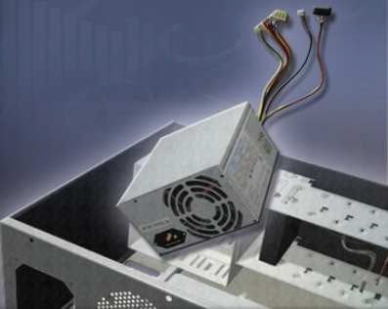
Open the Case
Prepare the workspace before opening case:
Adequate lighting Good ventilation
Comfortable room temperature Workbench accessible from all sides
Avoid cluttering workbench
An antistatic mat on the table
Small containers to hold screws and other small parts
There are different methods for opening cases. To learn how, consult the user manual or manufacturer's website.
the computer
ITE PC v4.0
Chapter 3
© 2007 Cisco Systems, Inc. All rights reserved. Jad njeim
3
Install the Power Supply
Power supply installation steps include the following:
Insert the power supply into the case
Align the holes in the power supply with the holes in the case
Secure the power supply to the case using the proper screws
ITE PC v4.0
Chapter 3
© 2007 Cisco Systems, Inc. All rights reserved.
Jad njeim
4

Slide 3
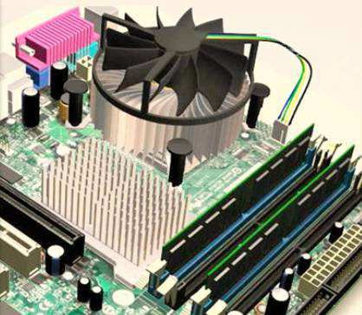
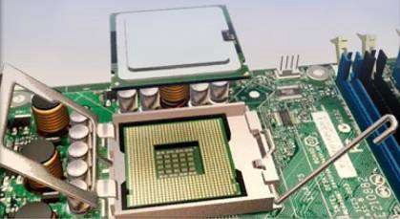
Attach Components to the Motherboard
As part of an upgrade or repair, a technician may need to attach components to the motherboard, and then install the motherboard.
ITE PC v4.0
Chapter 3
© 2007 Cisco Systems, Inc. All rights reserved.
Jad njeim
5
CPU on Motherboard
The CPU and motherboard are sensitive to electrostatic discharge so use a grounded antistatic mat and wear an antistatic wrist strap. CAUTION: When handling a CPU, do not touch the CPU contacts.
The CPU is secured to the socket on the motherboard with a locking assembly.
ITE PC v4.0
Chapter 3
© 2007 Cisco Systems, Inc. All rights reserved.
Jad njeim
6

Slide 4
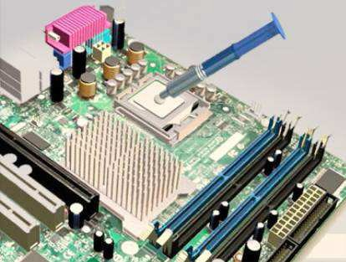
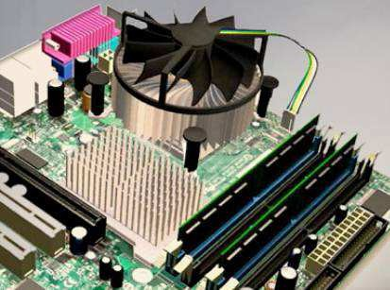
Thermal Compound
Thermal compound helps to keep the CPU cool.
To install a used CPU, clean it and the base of the heat sink with isopropyl alcohol to remove the old thermal compound.
Follow manufacturer’s recommendations about applying the thermal compound.
ITE PC v4.0
Chapter 3
© 2007 Cisco Systems, Inc. All rights reserved.
Jad njeim
7
Heat Sink/Fan Assembly
The Heat Sink/Fan Assembly is a two-part cooling device.
  The heat sink draws heat away from the CPU.
  The fan moves the heat away from the heat sink.
  The heat sink/fan assembly usually has a 3- pin power connector.
ITE PC v4.0
Chapter 3
© 2007 Cisco Systems, Inc. All rights reserved.
Jad njeim
8

Slide 5
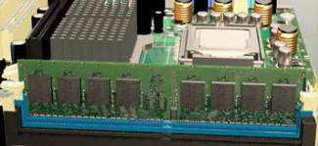
Install CPU and Heat Sink/Fan Assembly
Align the CPU so that the Connection 1 indicator is lined up with Pin 1 on the CPU socket.
Place the CPU gently into the socket.
Close the CPU load plate and secure it by closing the load lever and moving it under the load lever retention tab.
Apply a small amount of thermal compound to the CPU and spread it evenly. Follow the application instructions provided by the manufacturer.
Line up the heat sink/fan assembly retainers to the holes on the motherboard.
Place the heat sink/fan assembly onto the CPU socket, being careful not to pinch the CPU fan wires.
Tighten the heat sink/fan assembly retainers to secure the assembly in place.
Connect the heat sink/fan assembly power cable to the header on the motherboard.
© 2007 Cisco Systems, Inc. All rights reserved. Jad njeim
ITE PC v4.0
Chapter 3
9
Install RAM
RAM provides temporary data storage for the CPU while the computer is operating.
RAM should be installed in the motherboard before the motherboard is placed in the computer case.
RAM installation steps:
  Align the notches on the RAM module to the keys in the slot and press down until the side tabs click into place.
  Make sure that the side tabs have locked the RAM module and visually check for exposed contacts.
ITE PC v4.0
Chapter 3
© 2007 Cisco Systems, Inc. All rights reserved.
Jad njeim
10

Slide 6
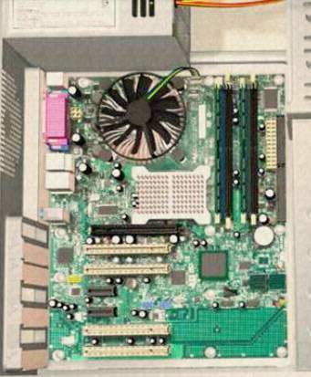
The Motherboard
The motherboard is now ready to install in the computer case.
Plastic and metal standoffs are used to mount the motherboard and to prevent it from touching the metal portions of the case.
Install only the standoffs that align with the holes in the motherboard.
Installing any additional standoffs may prevent the motherboard from being seated properly in the computer case.
ITE PC v4.0
Chapter 3
© 2007 Cisco Systems, Inc. All rights reserved.
Jad njeim
11
Install Motherboard
Install standoffs in the computer case.
Align the I/O connectors on the back of the motherboard with the openings in the back of the case.
Align the screw holes of the motherboard with the standoffs.
Insert all of the motherboard screws.
Tighten all of the motherboard screws.
© 2007 Cisco Systems, Inc. All rights reserved. Jad njeim
ITE PC v4.0
Chapter 3
12

Slide 7
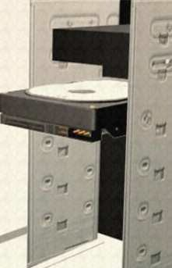
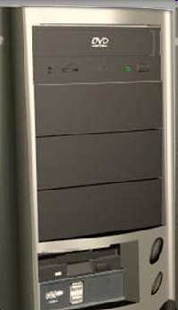
Install Internal Drives
Drives that are installed in internal bays are called internal drives.
A hard disk drive (HDD) is an example of an internal drive.
HDD installation steps:
  Position the HDD so that it aligns with the 3.5-inch drive bay.
  Insert the HDD into the drive bay so that the screw holes in the drive line up with the screw holes in the case.
  Secure the HDD to the case using the proper screws.
ITE PC v4.0
Chapter 3
© 2007 Cisco Systems, Inc. All rights reserved.
Jad njeim
13
Install Drives in External Bays
Drives, such as optical drives (CD and DVD) and floppy drives, are installed in drive bays that are accessed from the front of the case.
Optical drives and floppy drives store data on removable media.
Drives in external bays allow access to the media without opening the case.
ITE PC v4.0
Chapter 3
© 2007 Cisco Systems, Inc. All rights reserved.
Jad njeim
14

Slide 8
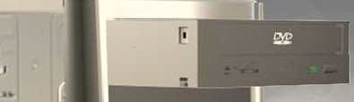
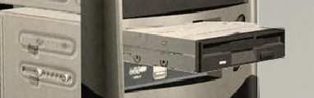
Install Optical Drive
An optical drive is a storage device that reads and writes information to CDs or DVDs.
Optical drive installation steps:
  Position the optical drive to align with the 5.25 inch drive bay.
  Insert the optical drive into the drive bay so that the optical drive screw holes align with the screw holes in the case.
  Secure the optical drive to the case using the proper screws.
ITE PC v4.0
Chapter 3
© 2007 Cisco Systems, Inc. All rights reserved.
Jad njeim
15
Install Floppy Drive
A floppy disk drive (FDD) is a storage device that reads and writes information to a floppy disk.
FDD installation steps:
  Position the FDD so that it aligns with the 3.5 inch drive bay.
  Insert the FDD into the drive bay so that the FDD screw holes align with the screw holes in the case.
  Secure the FDD to the case using the proper screws.
ITE PC v4.0
Chapter 3
© 2007 Cisco Systems, Inc. All rights reserved.
Jad njeim
16

Slide 9
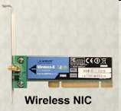
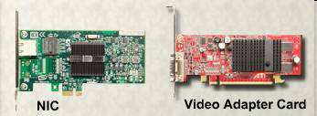
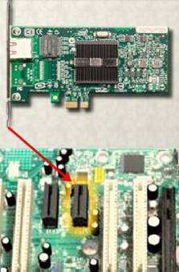
Install Adapter Cards
Adapter cards are installed to add functionality to a computer.
Adapter cards must be compatible with the expansion slot.
Some adapter cards:
PCIe x1 NIC
PCI Wireless NIC
PCIe x16 video adapter card
ITE PC v4.0
Chapter 3
© 2007 Cisco Systems, Inc. All rights reserved.
Jad njeim
17
Install the Network Interface Card (NIC)
A NIC enables a computer to connect to a network.
NICs use PCI and PCIe expansion slots on the motherboard.
  NIC installation steps:
    Align the NIC to the appropriate slot on the motherboard.
    Press down gently on the NIC until the card is seated.
    Secure the NIC PC mounting bracket to the case with the appropriate screw.
ITE PC v4.0
Chapter 3
© 2007 Cisco Systems, Inc. All rights reserved.
Jad njeim
18

Slide 10
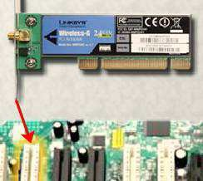
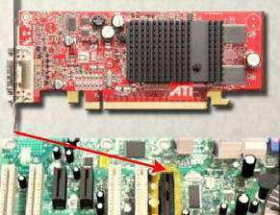
Install the Wireless NIC
A wireless NIC enables a computer to connect to a wireless network.
Some wireless NICs are installed externally with a USB connector.
Wireless NIC installation steps:
  Align the wireless NIC to the appropriate expansion slot on the motherboard.
  Press down gently on the wireless NIC until the card is fully seated.
  Secure the mounting bracket to the case with the appropriate screw.
ITE PC v4.0
Chapter 3
© 2007 Cisco Systems, Inc. All rights reserved.
Jad njeim
19
Install the Video Adapter Card
A video adapter card is the interface between a computer and a display monitor.
An upgraded video adapter card can provide better graphic capabilities for games and graphic programs.
Video adapter card installation steps:
  Align the video adapter card to the appropriate expansion slot on the motherboard.
  Press down gently on the video adapter card until the card is fully seated.
  Secure the video adapter card PC mounting bracket to the case with the appropriate screw.
ITE PC v4.0
Chapter 3
© 2007 Cisco Systems, Inc. All rights reserved.
Jad njeim
20

Slide 11
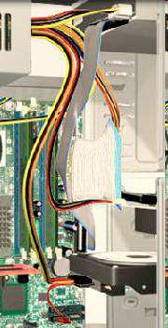
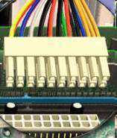
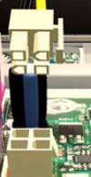
Connect Internal Cables
Power cables are used to distribute electricity from the power supply to the motherboard and other components.
Data cables transmit data between the motherboard and storage devices, such as hard drives.
Additional cables connect the buttons and link lights on the front of the computer case to the motherboard.
ITE PC v4.0
Chapter 3
© 2007 Cisco Systems, Inc. All rights reserved.
Jad njeim
21
Connect Power Cables
Motherboard Power Connections
The Advanced Technology Extended (ATX) main power connector has either 20 or 24 pins.
  The power supply may also have a 4-pin or 6-pin Auxiliary (AUX) power connector that connects to the motherboard.
  A 20-pin connector will work in a motherboard with a 24-pin socket.
ITE PC v4.0
Chapter 3
© 2007 Cisco Systems, Inc. All rights reserved.
Jad njeim
22

Slide 12
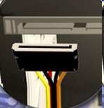

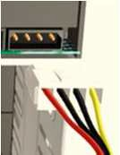
Connect Power Cables SATA Power Connectors use a 15-pin connector to connect to hard disk drives, optical drives, or any devices that have a SATA power socket. ^{SATA} Molex Power Connectors are used by hard disk drives and optical drives that do not have SATA power sockets.
Berg | CAUTION: Do not use a Molex connector and
a SATA power connector on the same drive at the same time. 4-pin Berg Power Connector supplies power to Molex a floppy drive. ITE PC v4.0 Chapter 3 © 2007 Cisco Systems, Inc. All rights reserved. Jad njeim 23
Power Connector Installation Steps
Plug the SATA power connector into the HDD.
Plug the Molex power connector into the optical drive.
Plug the 4-pin Berg power connector into the FDD.
Connect the 3-pin fan power connector into the appropriate fan header on the motherboard, according to the motherboard manual.
Plug the additional cables from the case into the appropriate connectors according to the motherboard manual.
ITE PC v4.0
Chapter 3
© 2007 Cisco Systems, Inc. All rights reserved.
Jad njeim
24

Slide 13

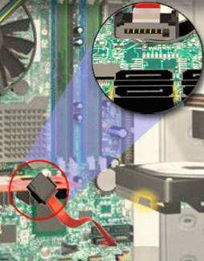
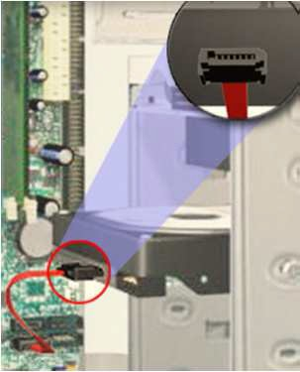
PATA Cables
Drives connect to the motherboard using data cables.
Types of data cables are PATA, SATA, and floppy disk.
The PATA cable (sometimes called a ribbon cable) is wide and flat and can have either 40 or 80 conductors.
A PATA cable usually has three 40-pin connectors.
If multiple hard drives are installed, the master drive will connect to the end connector. The slave drive will connect to the middle connector.
Many motherboards have two PATA cable sockets, which provides support for a maximum of four PATA drives.
ITE PC v4.0
Chapter 3
© 2007 Cisco Systems, Inc. All rights reserved.
Jad njeim
25
SATA Cables
The SATA data cable has a 7-pin connector.
One end of the cable is connected to the motherboard.
The other end is connected to any drive that has a SATA data connector.
ITE PC v4.0
Chapter 3
© 2007 Cisco Systems, Inc. All rights reserved.
Jad njeim
26

Slide 14
Floppy Drive Cables
The floppy drive data cable has a 34-pin connector and it has a stripe to denote the location of pin 1.
One connector at the end of the cable connects to the motherboard. The other two connectors connect to drives.
If multiple floppy drives are installed, the A: drive will connect to the end connector. The B: drive will connect to the middle connector.
Motherboards have one floppy drive controller which provides support for a maximum of two floppy drives.
ITE PC v4.0
Chapter 3
© 2007 Cisco Systems, Inc. All rights reserved.
Jad njeim
27
Install Data Cables
Plug the motherboard end of the PATA cable into the motherboard socket.
Plug the connector at the far end of the PATA cable into the optical drive.
Plug one end of the SATA cable into the motherboard socket.
Plug the other end of the SATA cable into the HDD.
Plug the motherboard end of the FDD cable into the motherboard socket.
Plug the connector at the far end of the FDD cable into the floppy drive.
© 2007 Cisco Systems, Inc. All rights reserved. Jad njeim
ITE PC v4.0
Chapter 3
28

Slide 15
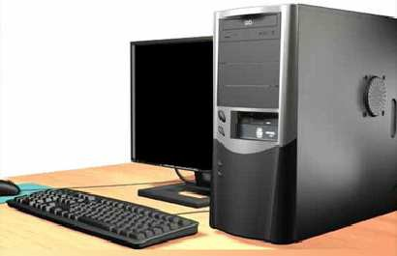

Re-attach Panels, Connect External Cables
Now that all the internal components have been installed and connected to the motherboard and power supply, the side panels are re-attached to the computer case.
The next step is to connect the cables for all computer peripherals and the power cable.
ITE PC v4.0
Chapter 3
© 2007 Cisco Systems, Inc. All rights reserved.
Jad njeim
29
Re-attach Side Panels
Most computer cases have two panels, one on each side.
Once the cover is in place, make sure that it is secured at all screw locations.
Refer to the documentation or manufacturer’s website if you are unsure about how to remove or replace your computer case.
CAUTION: Handle case parts with care. Some computer case covers have sharp or jagged edges.
ITE PC v4.0
Chapter 3
© 2007 Cisco Systems, Inc. All rights reserved.
Jad njeim
30

Slide 16
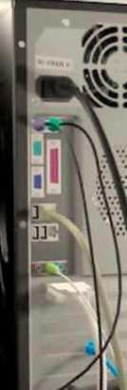
Connect External Cables
After the case panels have been re-attached, connect the external cables to the back of the computer.
External cable connections include:
Monitor Keyboard Mouse
USB
Power Ethernet
CAUTION: When attaching cables, never force a connection.
NOTE: Plug in the power cable after you have connected all other cables.
ITE PC v4.0
Chapter 3
© 2007 Cisco Systems, Inc. All rights reserved.
Jad njeim
31
Connect External Cables
Attach the monitor cable to the video port.
Secure the cable by tightening the screws on the connector.
Plug the keyboard cable into the PS/2 keyboard port.
Plug the mouse cable into the PS/2 mouse port.
Plug the USB cable into a USB port.
Plug the network cable into the network port.
Connect the wireless antenna to the antenna connector.
Plug the power cable into the power supply.
ITE PC v4.0
Chapter 3
© 2007 Cisco Systems, Inc. All rights reserved.
Jad njeim
32

Slide 17
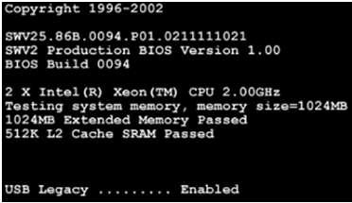
Boot Computer for the First Time
The BIOS is a set of instructions stored in a nonvolatile
memory chip.
When the computer is booted, the basic input/output system (BIOS) will perform a power-on self test (POST) to check on all of the internal components.
A special key or combination of keys on the keyboard is used to enter the BIOS setup program.
The BIOS setup program displays information about all of
ITE PC v4.0
Chapter 3
the components in the computer.
© 2007 Cisco Systems, Inc. All rights reserved.
Jad njeim
33
Identify Beep Codes
POST checks to see that all of the hardware in the computer is operating correctly.
If a device is malfunctioning, an error or a beep code alerts the technician that there is a problem.
Typically, a single beep denotes that the computer is functioning properly.
If there is a hardware problem, the computer may emit a series of beeps.
Each BIOS manufacturer uses different codes to indicate hardware problems.
Consult the motherboard documentation to view beep codes for your computer.
ITE PC v4.0
Chapter 3
© 2007 Cisco Systems, Inc. All rights reserved. Jad njeim
34

Slide 18
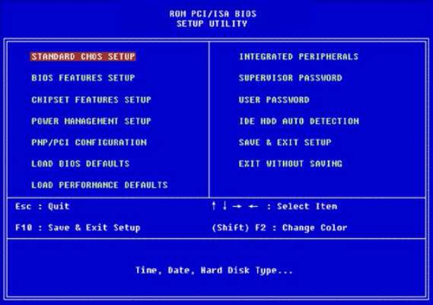
BIOS Setup
The BIOS contains a setup program used to configure settings for hardware devices.
The configuration data is saved to a special memory chip called a complementary metal-oxide semiconductor (CMOS).
CMOS is maintained by the battery in the computer.
If this battery dies, all BIOS setup configuration data will be lost.
Replace the battery and reconfigure the BIOS settings.
ITE PC v4.0
Chapter 3
© 2007 Cisco Systems, Inc. All rights reserved.
Jad njeim
35
BIOS Setup Program
BIOS settings are configured in the BIOS setup program.
ITE PC v4.0
Chapter 3
© 2007 Cisco Systems, Inc. All rights reserved.
Jad njeim
36

Slide 19

ITE PC v4.0
Chapter 3
© 2007 Cisco Systems, Inc. All rights reserved.
Jad njeim
37

